Slide 1
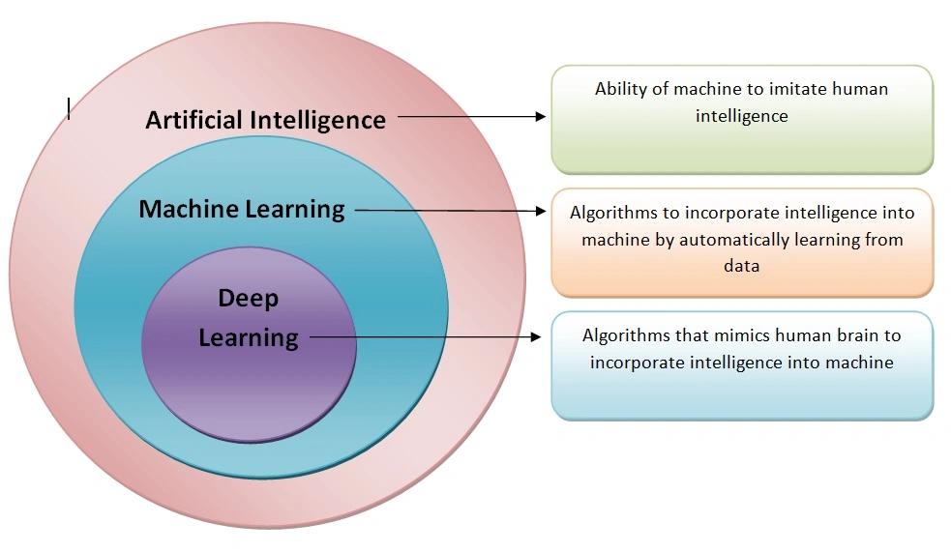
Learning Paradigms in AI

Slide 2
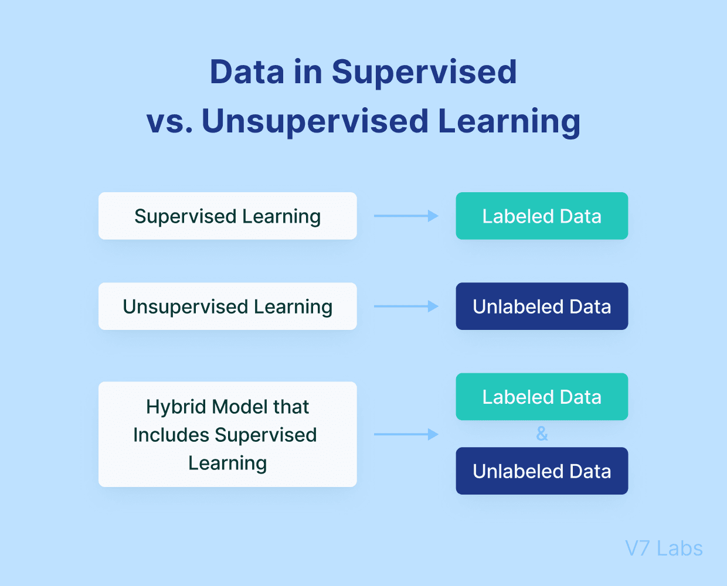
Supervised and Unsupervised Learning
Supervised learning is a type of machine learning in which a model is trained against a labelled dataset.
Unsupervised learning is a sort of machine learning in which the model is trained on data without explicit labels or predetermined outcomes.

Slide 3
Supervised Learning
Step-by-step overview of how it works:
Collect Data
Prepare the Data
Choose a model
Train the model
Evaluate the Model
Tune the Model
Deploy the Model

Slide 4
Unsupervised Learning
Step-by-step overview of how it works:
Collect Data
Prepare the Data
Choose a model
4. Train the Model
5. Evaluate the Results
6. Interpret and Use the Findings
Clustering
Dimensionality Reduction
Anomaly Detection
Association Rules

Slide 5
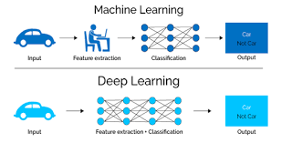
Deep Learning
Deep Learning is branch of machine learning solves complicated issues by utilizing multi-layered neural networks.

Slide 6
Breakdown of Deep Learning
Neural Networks
• Input Layer
• Hidden Layers
• Output Layer
2. Architecture
3. Training Process
• Forward Propagation
• Loss Function

Slide 7
• Backpropagation
• Optimisation
4. Types of Deep Learning Models
• Feedforward Neural Networks (FNNs)
• Convolutional Neural Networks (CNNs)
• Recurrent Neural Networks (RNNs)
• Networks with Long Short-Term Memory (LSTMs)
• Transformers

Slide 8
5. Applications
• Image and Video
• Natural Language Processing
• Speech Recognition
• Healthcare
6. Challenges
• Data requirements
• Computational Resources
• Interpretability

Slide 9
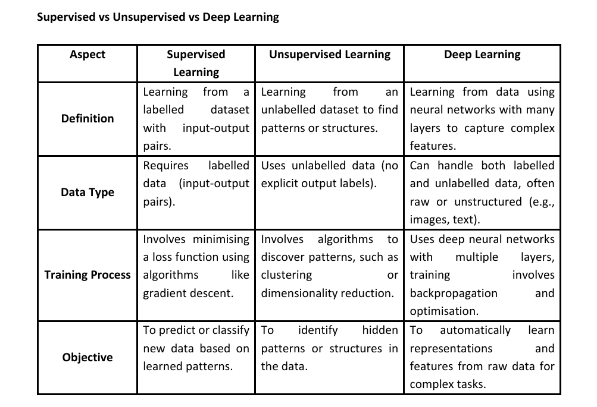

Slide 10
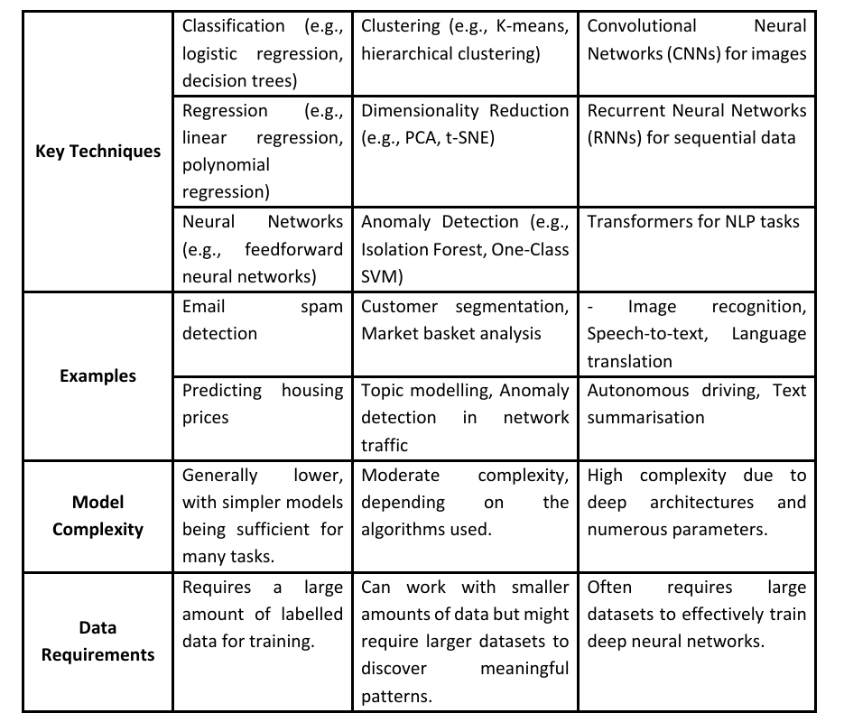

Slide 11
